Slide 1
THE LAST SUPPER
By Danny,Orlando and Luke.

Slide 2
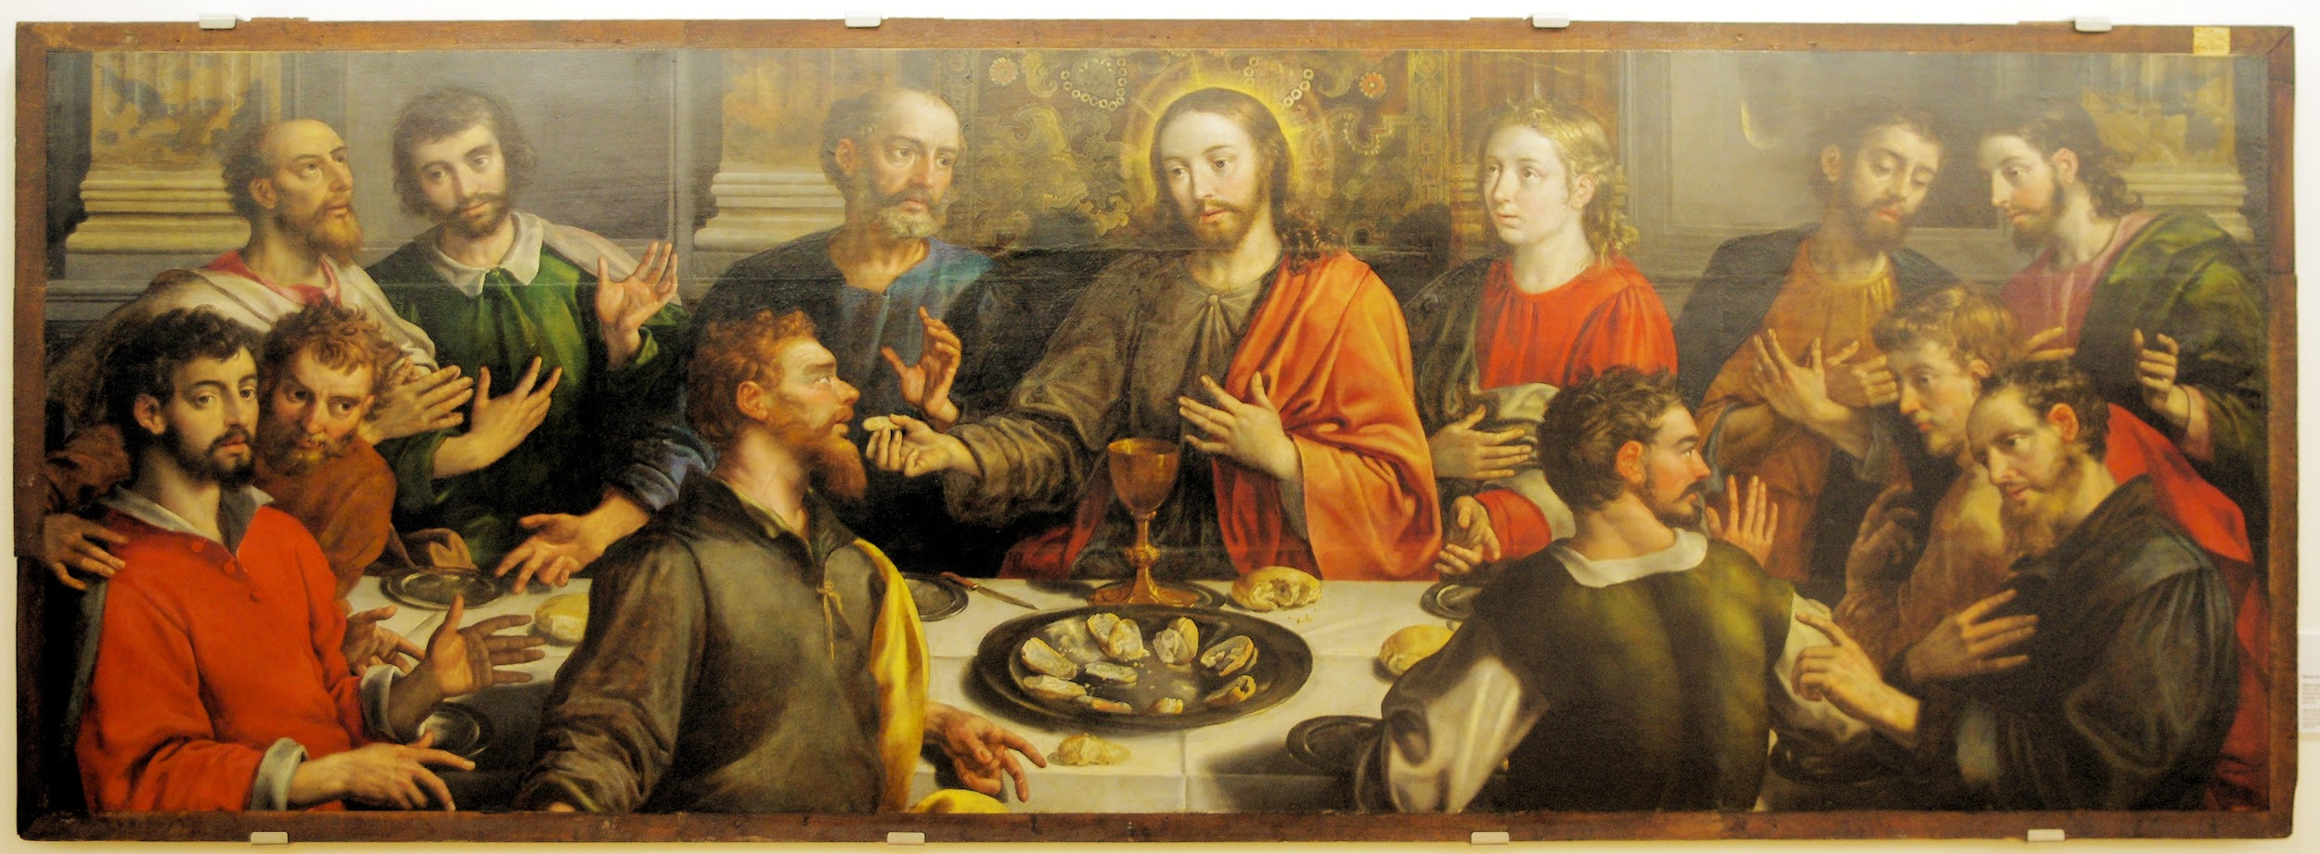
At the last supper Jesus said “eat this bread it is my body,drink this wine it is my blood”

Slide 3
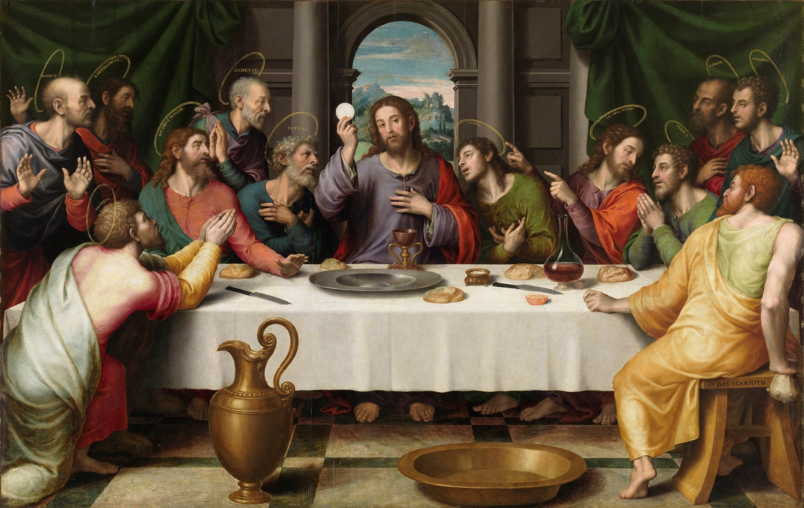

Slide 4
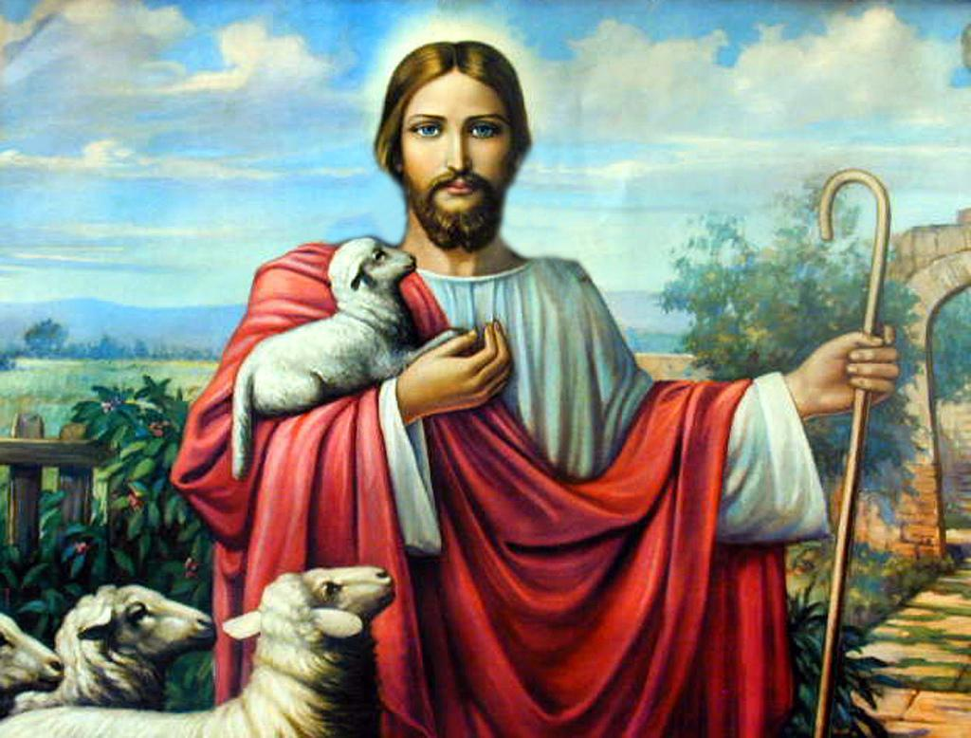
At the last supper Jesus said “one of you will betray me” everyone was shocked. Gudas was sitting next to Jesus.Then he said “lord am I the one” Jesus said”yes you are the one” Gudas was angry Jesus knew what he was going to do.
JESUS

Slide 5
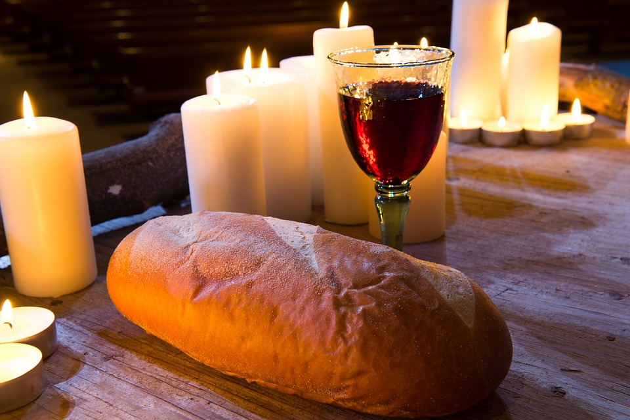
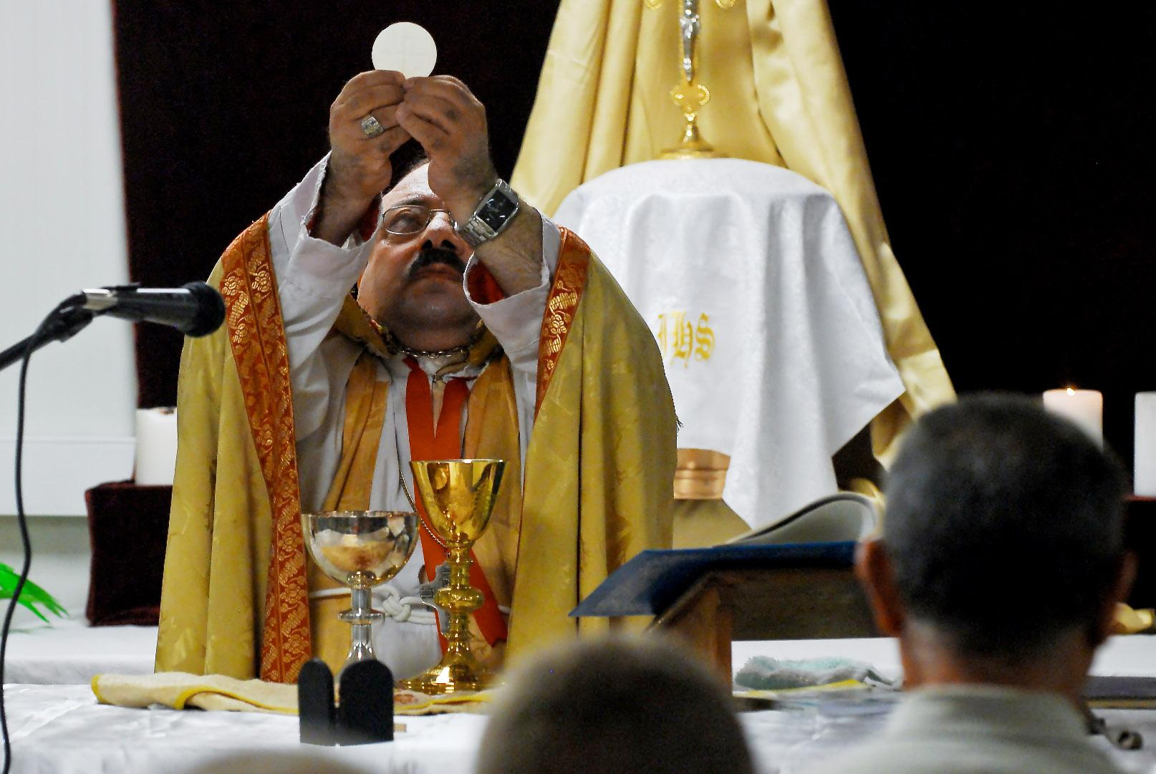
At church we drink the wine and eat the bread

